Slide 1
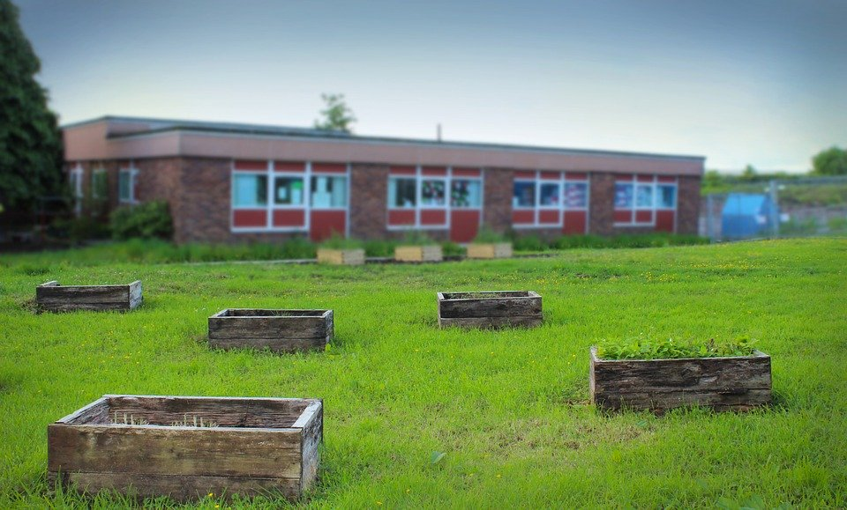
Welcome to Strawberry Hill Primary School
Our School | School Uniform | Subjects | School Clubs | School Lunch | Calendar
HOME
Notes:
https://pixabay.com/de/photos/schule-grundschule-east-kilbride-1048983/

Slide 2
Our School
HOME
Address: Strawberry Hill Primary School Hill Road London SE16 5SK Great Britain
Contact: Tel: 020 7652 9532
Email: info@strawberryhillprimary.co.uk
Head teacher: Mr David Miller
Team:
Class | Teacher
Reception | Ms Jenkins
Year 1 | Ms Davies
Year 2 | Mr Wilson
Year 3 | Ms Baker
Year 4 | Mr Singh
Year 5 | Ms Bloomfield
Year 6 | Ms McKenna

Slide 3
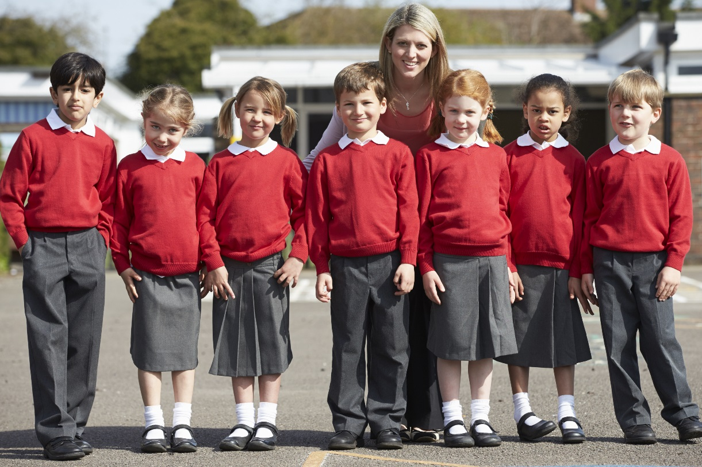
School Uniform
HOME
 | Summer | Winter
Girls | white blouse | white blouse
 | grey skirt | grey skirt
 | red dress | dark blue coat
 | red sweater | red sweater
 | white socks | black tights
 | black closed toe sandals | black leather shoes
Boys | white shirt | white shirt
 | grey shorts | grey trousers
 | red sweater | red sweater
 | grey socks | grey socks
 | black shoes | black leather shoes
 |  | dark blue coat
All children | dark grey book bag, grey school cap, water bottle labelled with name
Notes:
https://www.shutterstock.com/image-photo/elementary-school-pupils-teacher-playground-290587853

Slide 4
Subjects and Timetable Years 1 - 3
HOME
 | Monday | Tuesday | Wednesday | Thursday | Friday
8:45 – 9:00 | Quiet reading | Quiet reading | Quiet reading | Quiet reading | Quiet reading
9:00 – 10:30 | English | English | English | English | English
10:30 – 11:00 | BREAK
11:00 – 12:00 | Maths | Maths | Maths | Maths | Maths
12:00 – 1:00 | LUNCH
1:00 – 2:00 | Science | History | Geography | Science | Spanish
2:00 – 3:00 | PE | Music | Art | IT
3:00 – 3:30 | ASSEMBLY
Notes:
https://www.shutterstock.com/image-photo/teacher-reading-story-elementary-school-pupils-290587931?irgwc=1&utm_medium=Affiliate&utm_campaign=Pixabay+GmbH&utm_source=44814&utm_term=https%3A%2F%2Fpixabay.com%2Fde%2Fimages%2Fsearch%2Fprimary%2520school%2520children%2F

Slide 5
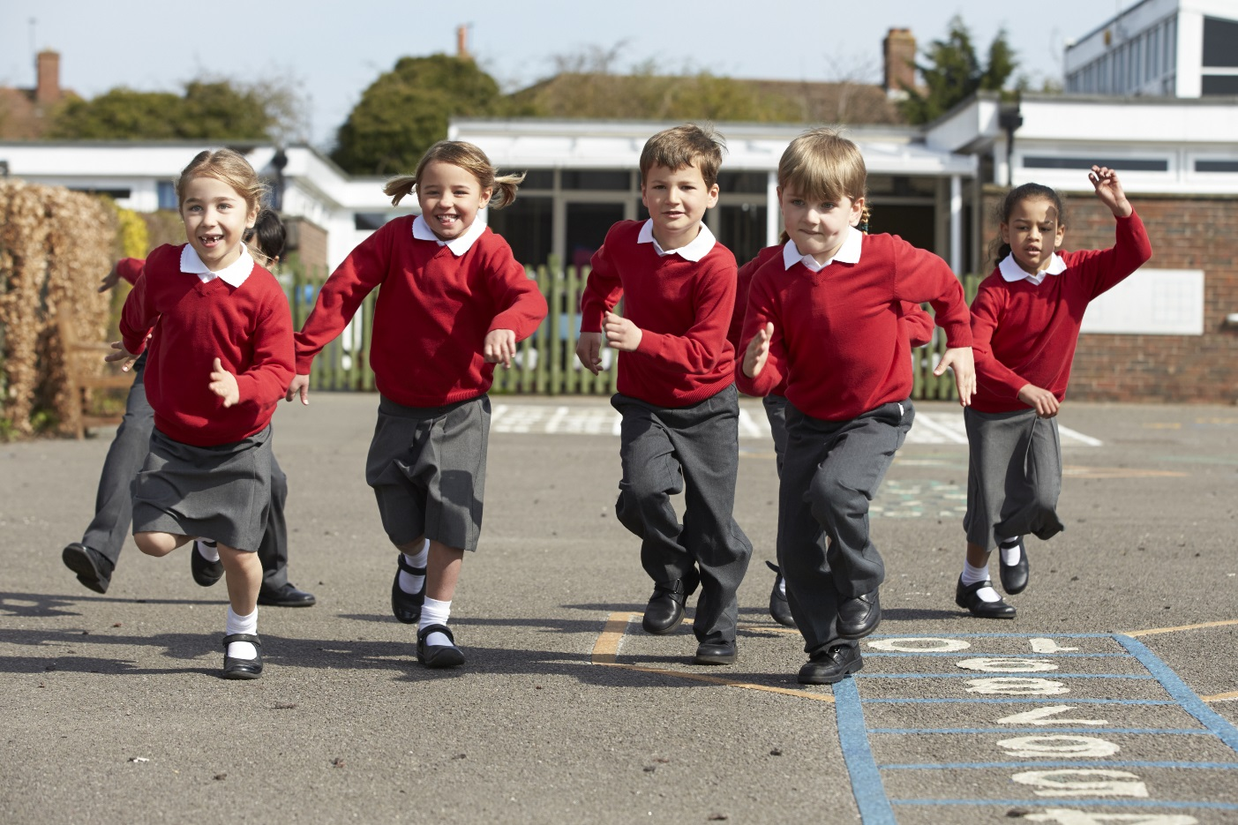
School Clubs
HOME
Home
https://www.shutterstock.com/image-photo/young-teacher-helping-one-his-primary-629766122?irgwc=1&utm_medium=Affiliate&utm_campaign=Pixabay+GmbH&utm_source=44814&utm_term=https%3A%2F%2Fpixabay.com%2Fde%2Fimages%2Fsearch%2Fprimary%2520school%2F
School clubs start at 3.30 pm.
Monday | Chess Cheerleading
Tuesday | Football (boys) Choir
Wednesday | Football (girls) Science Club
Thursday | Creative Writing Nature Club
Friday | Hockey Zumba
Notes:
https://www.shutterstock.com/image-photo/elementary-school-pupils-running-playground-284501777?irgwc=1&utm_medium=Affiliate&utm_campaign=Pixabay+GmbH&utm_source=44814&utm_term=https%3A%2F%2Fpixabay.com%2Fde%2Fimages%2Fsearch%2Fprimary%2520school%2520children%2F

Slide 6
School Lunch
HOME
Home
This week
Monday | Tuesday | Wednesday | Thursday | Friday
Baked chicken | Roast pork | Shepherd’s pie | Grilled fish | Pizza margherita
Basmati rice | Potatoes with herbs | Garlic bread | Roasted vegetables | Jacket wedges
Fresh carrots and broccoli | Butternut squash | Baked beans | Baked sweetcorn | Italian salad
Fresh fruit | Apple pie | Trifle | Fruit salad | Carrot cake
Notes:
https://www.shutterstock.com/image-photo/schoolchildren-teacher-sitting-table-eating-lunch-284502176

Slide 7
Calendar
HOME
Home
The school day starts at 9am and ends at 3.30 pm, Monday to Friday. Classrooms open at 8.45am for reading and settling in.
Term dates
Autumn
Term starts | Monday 7 September
Half term | Monday 26 – Friday 30 October
Term ends | Friday 18 December
Spring
Term starts | Tuesday 5 January
Half term | Monday 15 – Friday 19 February
Term ends | Wednesday 31 March
Summer
Term starts | Monday 19 April
May Day Bank Holiday | Monday 3 May
Half term | Monday 31 May – Friday 4 June
Term ends | Friday 23 July

