Slide 1
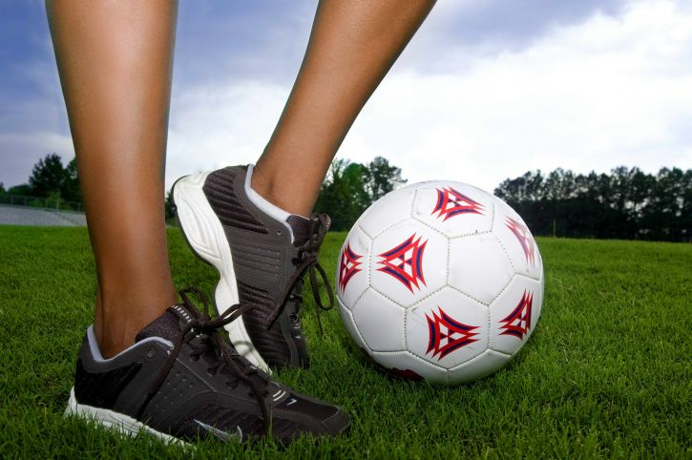
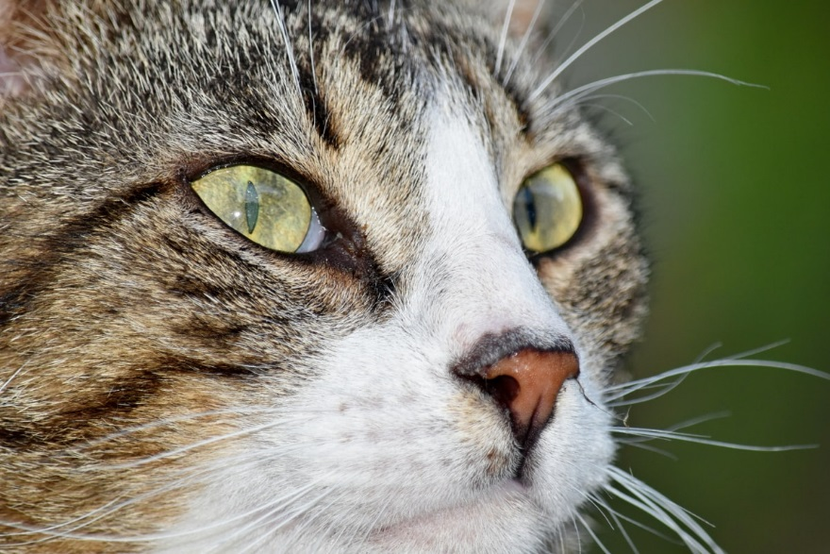
Svenja
I‘m from Magdeburg in Germany.
I have two younger brothers.
My favourite hobby is playing football. My favourite club is RB Leipzig.
I love cooking. My favourite food is pasta.
I don‘t have a pet, but I love cats.
Instagram is boring, but I like watching YouTube videos.
My favourite season is summer because I love swimming and riding my bike.

